Slide 1
Solid Mechanics Project
topic :To calculate deflection of a rod at different points and compare it to theoretical values.

Slide 2
theory
In structural engineering, deflection is the degree to which a part of a structural element is displaced under a load (because it deforms). It may refer to an angle or a distance.
One of the most important applications of beam deflection is to obtain equations with which we can determine the accurate values of beam deflections in many practical cases. Deflections are also used in the analysis of statically indeterminate beams.

Slide 3
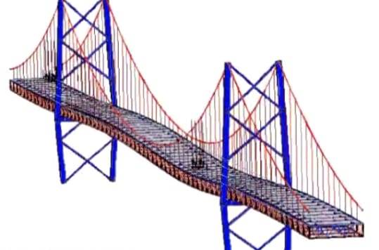
Application

Slide 4
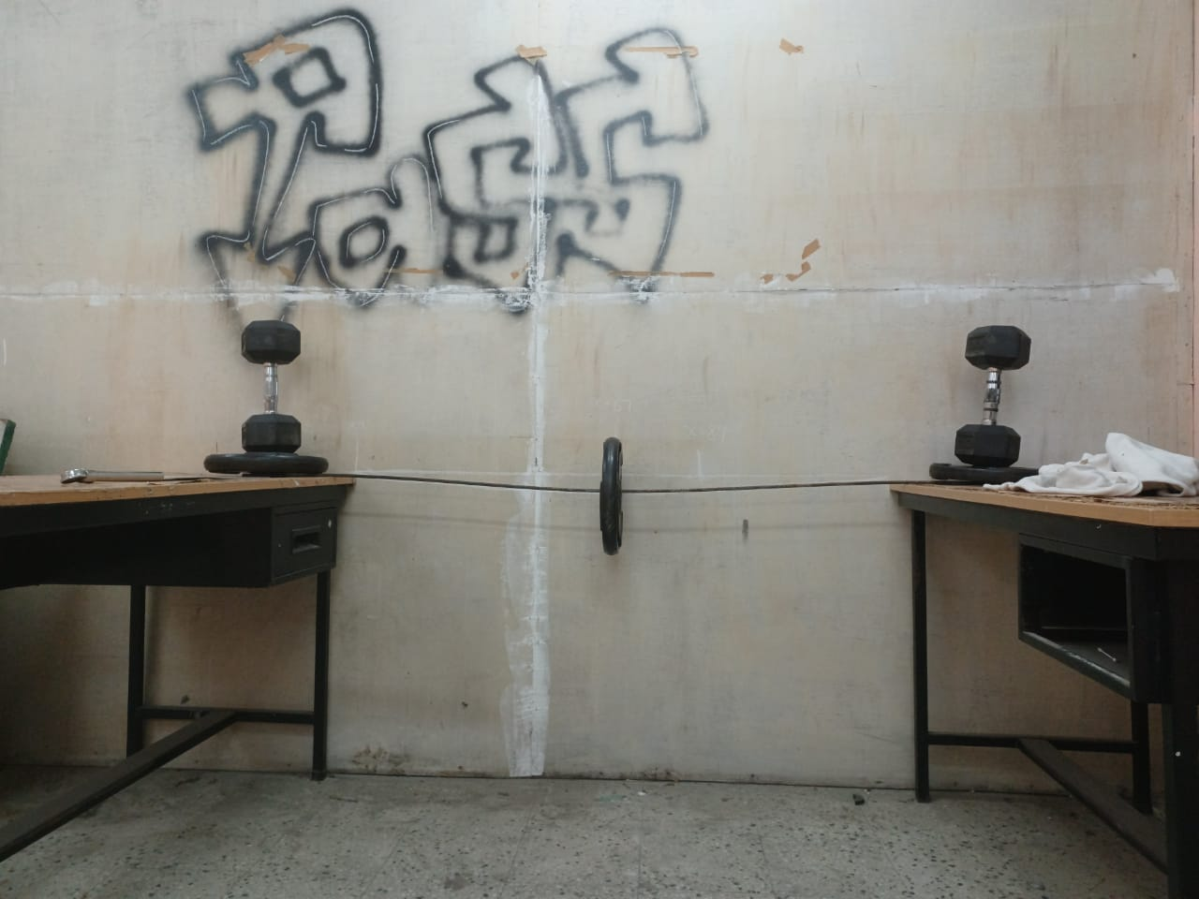
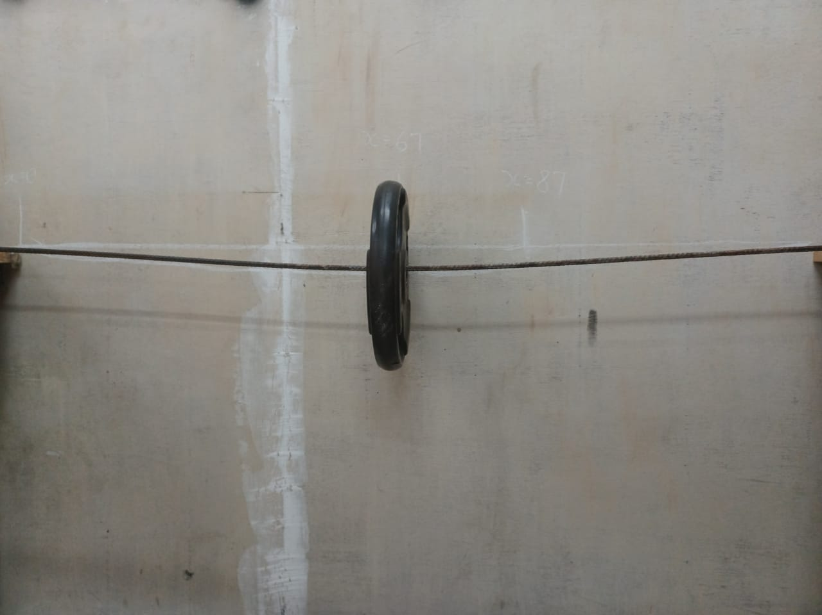

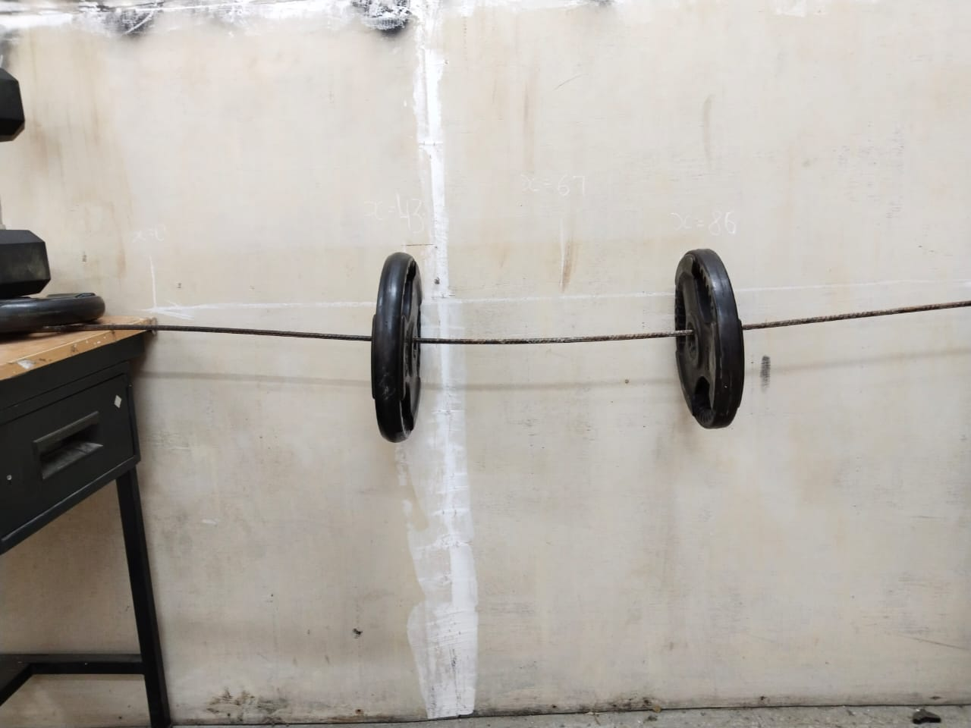

Slide 5
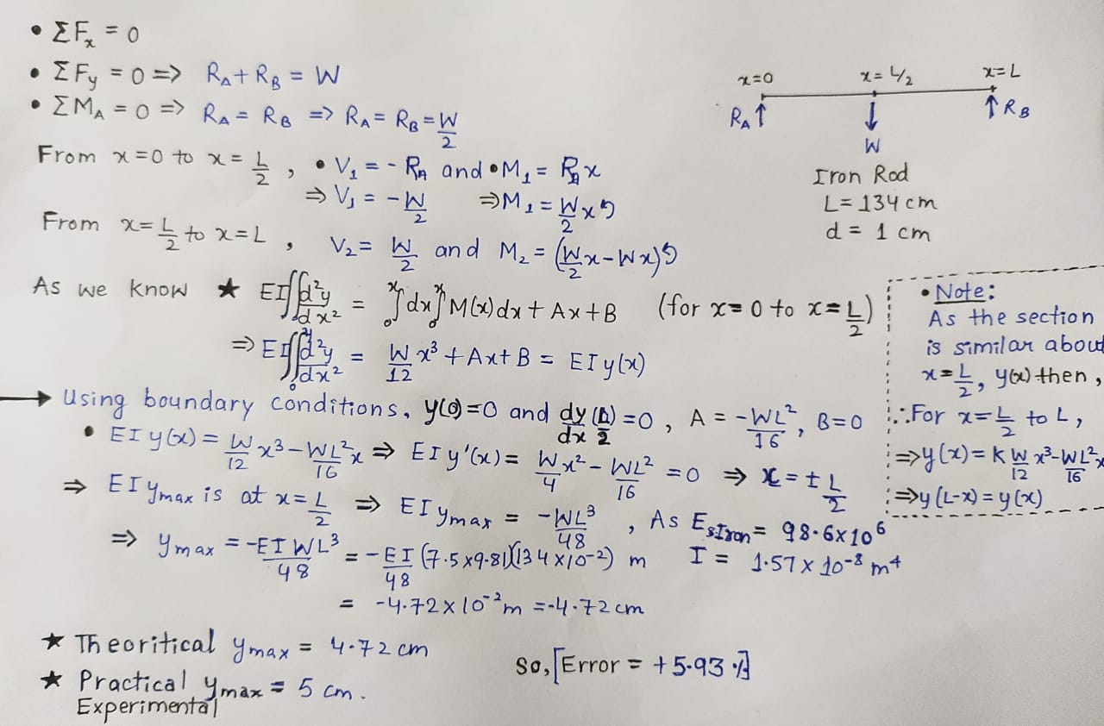
Calculations

